Slide 1
Networks and Communication
Module 4 Network Layer

Slide 2
Contents
IPV4
IPV6
IPV6 – Flow label
IPV6 – Next Address
IPV6 - CIDR
Anycast
IPV6 Address
IPV6 to IPV4
IPV6 to IPV4

Slide 3
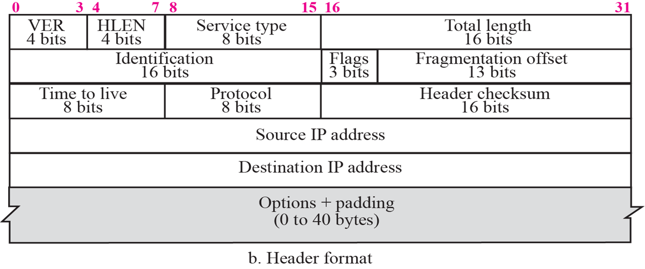
IPV4
Version – 0100(04)
HLEN – Header Length 4 bits (0-15)
IPV4 header 20 bytes (5)
Max header 15*4=60 bytes
Service Type – QOS
Total Length – 16 bits
65536 bytes
Identification – 16 bits
Fragmentation ID
TCP IP Protocol Suite - Behrouz A. Forouzan

Slide 4
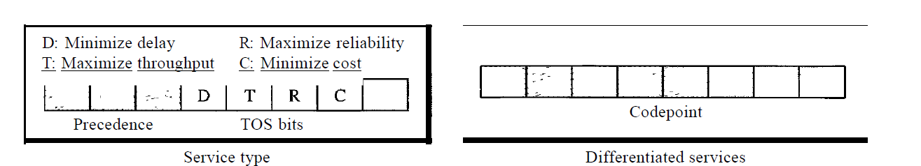
Service Type or Differentiated Services

Slide 5
IPV4
Fragment flag – 3 bits
Reserve – one bit
Do not fragment = 1
Fragment allowed = 0
More fragments = 1,
Last fragment = 0

Slide 6
IPV4
Fragmentation offset 13bits?
To assemble the fragmented packets sequentially – relative to first packet
Multiple of 8 bytes
Measured in units of 8 bytes

Slide 7
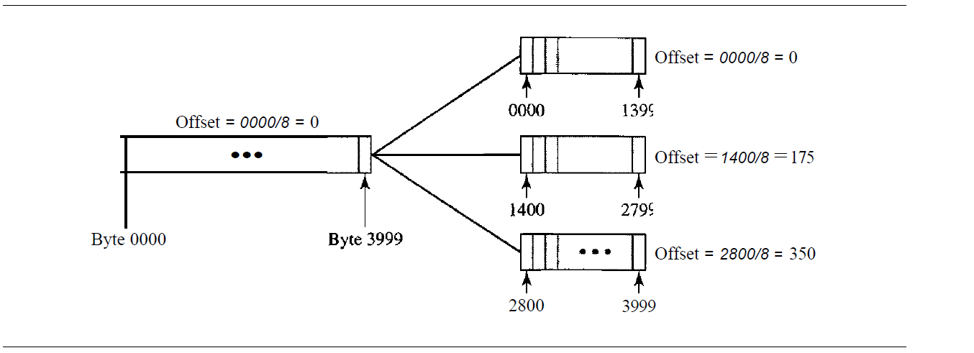

Slide 8
IPV4
Time to Live – 8 bits
Decremented at each router
Packet dropped at 0
Prevents recirculation in
internet
Header checksum
TCP IP Protocol Suite - Behrouz A. Forouzan

Slide 9
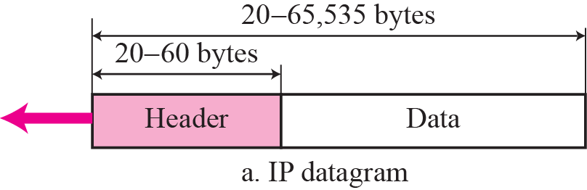
IPV4
Protocols
Multiplexing/Demultiplexing
ICMP = 01,
IGMP = 02,
TCP = 6,
UDP = 17,
OSPF = 89
TCP IP Protocol Suite - Behrouz A. Forouzan

Slide 10
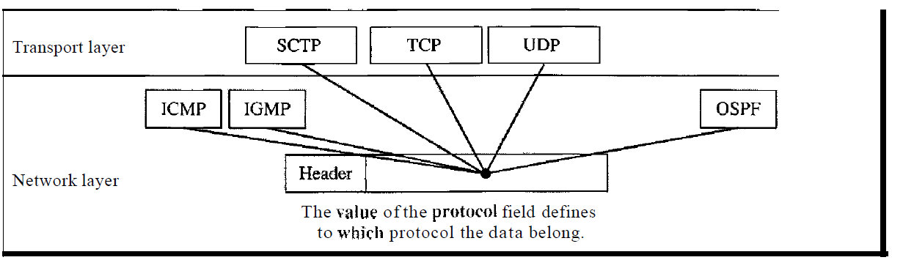

Slide 11
IPV4
Options
Source routing
Tracerouting
Timestamp
Many more
IPV4 follows BigEndian system.
Largest value first
https://en.wikipedia.org/wiki/IPv4
Options

Slide 12
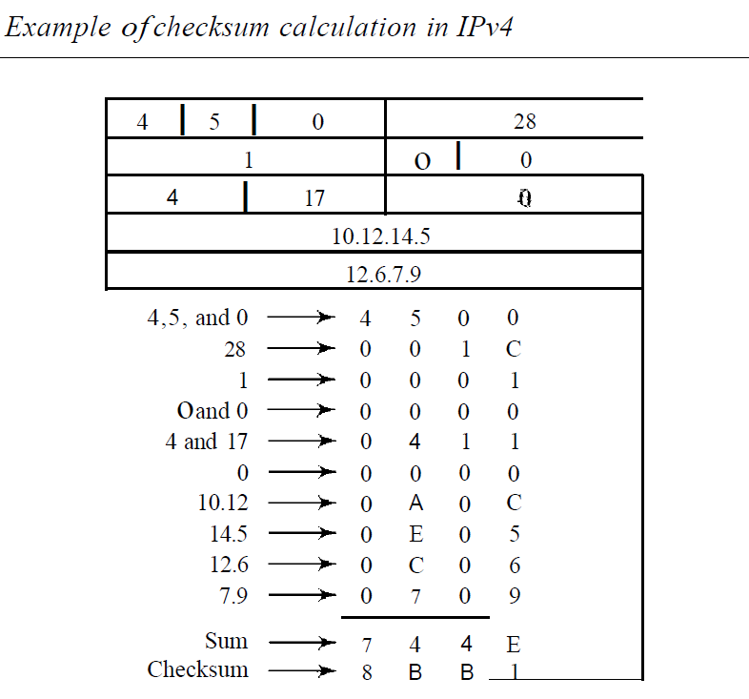

Slide 13
IPV4
An IPv4 packet has arrived with the first 8 bits as shown: 0100010.
Analyze validity of IP Packet
Notes:
#1. The 4 leftmost bits (0100) show the version, which is correct.
The next 4 bits (0010) show an invalid header length (2 x 4 = 8). The minimum number of bytes in the header must be 20.
The packet has been corrupted in transmission.

Slide 14
IPV4
In an IPv4 packet, the value of HLEN is 1001 in binary.
Find if option field is occupied or not?
Notes:
#2 HLEN = 9 => 36 bytes. Regular IP is 20 bytes. 16 bytes of IP options are carried in IP packet.

Slide 15
IPV4
In an IPv4 packet, the value of HLEN is 5, and the value of the total length field is 0x0028. How many bytes of data are being carried by this packet?
Notes:
#3 The HLEN value is 5, which means the total number of bytes in the header is 5 x 4, or 20 bytes (no options). The total length is 40 bytes, which means the packet is carrying 20 bytes of data (40- 20).

Slide 16
Reasons for IPV6
Depletion of address in IPv4
Larger address space
The slowness of the process due to some unnecessary processing
IPv6 header separates base header and options
The desperate need for security
confidentiality and integrity of the packet by encryption and authentication options
The need for new options
New options for new additional functionality
Support for multimedia
Addition of flow label,
Traffic class for resource allocation

Slide 17
IPV6
The planet earth is approximately 2⁶⁰ square meters.
Still there are enough addresses to connect all computers to the Internet.
128 Bits address
If we can build a high-rise building over the land and sea to accommodate 2⁶⁸ computers in each square meter of the earth.
TCP IP Protocol Suite - Behrouz A. Forouzan

Slide 18
IPV6
If we assign 2⁶⁰ addresses to the users each year
Almost one billion each second
It will take 2⁶⁸ years to deplete addresses.
TCP IP Protocol Suite - Behrouz A. Forouzan

Slide 19
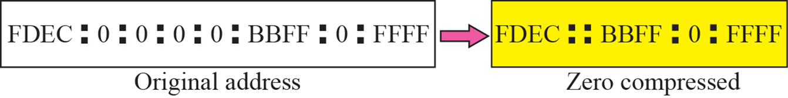
IPV6
Zero Compression in IPV6
TCP IP Protocol Suite - Behrouz A. Forouzan

Slide 20
The IPV6 address AAA0:00AA:0000:0000:0000:0A0A:0000:0000 can also be represented as:
AAA:AA::A0A:0:0
AAA0:AA::A0A:0:0
AAA0:AA::A0A::
AAA0:AA::::A0A:0:0
AAA0:AA:0:0:0:A0A::
ANSWER: B
Solution:
Zero compression should be done on the longest sequence of 0’s.

Slide 21
IPV6
Show abbreviations for the following addresses:
a. 0000:0000:FFFF:0000:0000:0000:0000:0000
b. 1234:2346:0000:0000:0000:0000:0000:1111
c. 0000:0001:0000:0000:0000:0000:1200:1000
d. 0000:0000:0000:0000:0000:FFFF:24.123.12.6
Solution
a. 0:0:FFFF::
b. 1234:2346::1111
c. 0:1::1200:1000
d. ::FFFF:24.123.12.6

Slide 22
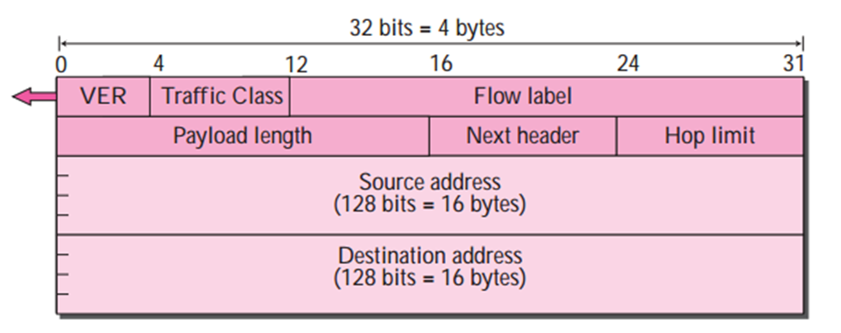
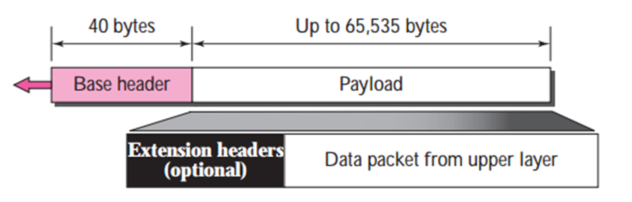
IPV6
Ver – 4 bits - 0110
Traffic Class. QOS
This 8-bit field is used to distinguish different payloads with different delivery requirements.
It replaces the service class field in IPv4.
TCP IP Protocol Suite - Behrouz A. Forouzan

Slide 23
IPV6
Hop Limit = TTL
time to live
Next Header = Options field
Payload – 16 bits – 65535 bytes
Source address – 16 bytes
Destination Header – 16 bytes
IPv6 header - 40 Bytes
TCP IP Protocol Suite - Behrouz A. Forouzan

Slide 24
IPV6
To a router, a flow is a sequence of packets sharing same characteristics,
The same source,
same destination,
same priority, and
same options.
Traveling the same path,
Using the same resources
Same kind of security
The flow label is a 20-bit field that is designed to provide special handling for a particular flow of data.
Random number 1 to 220 -1
To allow us to use IPv6 as a connection-oriented protocol
TCP IP Protocol Suite - Behrouz A. Forouzan
Notes:
IP protocol is connection less protocol
But Used as a connection oriented protocol
MPLS - to encapsulate an IPv4 packet in an MPLS header using a label field

Slide 25
IPV6 Flow Label
Router has a flow table
An entry for each active flow label
Each entry defines the services, QOS, required by the corresponding flow label
It consults its flow label table to find The corresponding entry for the flow label value defined in the packet.
It then provides the packet with the services mentioned in the entry

Slide 26
IPV6 Flow Label
A flow label can be used to Speed up the processing of a packet by a router
Need not look at Routing table
Going through a routing algorithm to find next hop address
Used to support the transmission of Real-time audio and video
Normally it requires high bandwidth, large buffers, long processing time.

Slide 27
IPV6 Flow Label
The use of real-time data requires
The reservation of resources
Require other protocols
RTP - Real-Time Protocol RSVP - Resource Reservation Protocol in addition to IPv6
A process can make a reservation for Resources beforehand to guarantee that real-time data will not be delayed due to a lack of resources.

Slide 28
IPV6 Flow Label
If a router does not support the flow label, It simply ignores it
If a host does not support the flow label,
It sets this field to zero.
A source must not reuse a flow label for a new flow while the existing flow is still alive

Slide 29
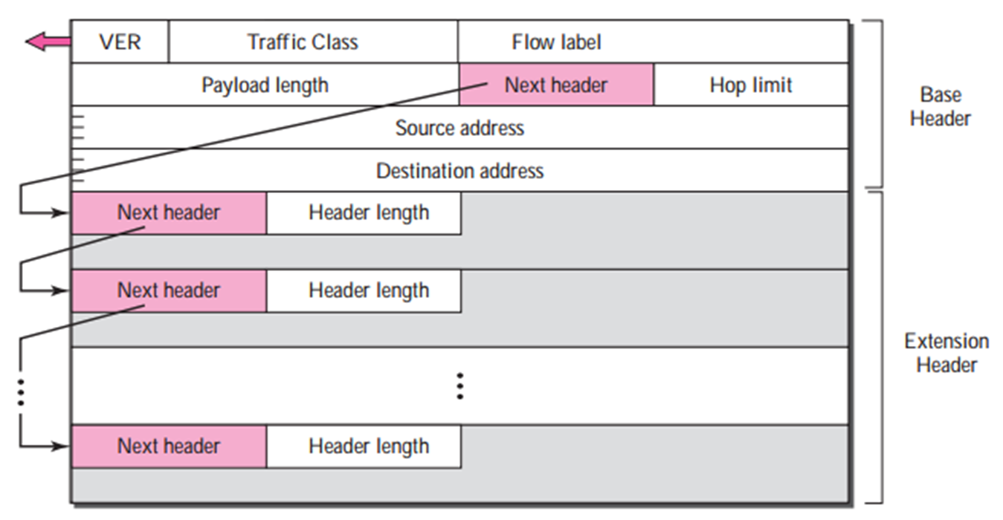
IPV6 Next Header
The header length defines the number of bytes in the header
Including the next header field.
TCP IP Protocol Suite - Behrouz A. Forouzan

Slide 30
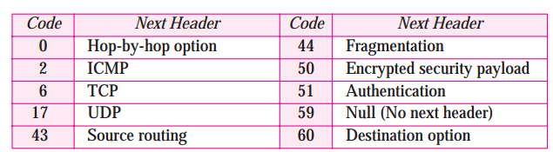
IPV6 Next Header
TCP IP Protocol Suite - Behrouz A. Forouzan

Slide 31
IPV6 Next Header
Source routing
Strict source route and the
Loose source route options
Fragmentation,
Authentication,
Encrypted security payload
Hop by Hop
Management, debugging, or control functions
Payload length more than 65535
Destination option pass information to the destination.
Intermediate routers are not permitted to access this information
Notes:
hop-by-hop option
management, debugging, or control functions
Payload length more than 65535
PAD 1
PAD n
Jumbo Payload

Slide 32
IPV6 vs IPv4
No header length - HLEN
Fixed header
No service type field
Flow label
No identification, flag, and offset fields
Included in the fragmentation extension header
No Checksum
Total length field
Replaced by payload length field.
TTL -> Hop limit
Protocol -> Next header
Option field -> Next Header
-> Extension header

Slide 33
IPV6 Next Header
Source routing
Strict source route and the Loose source route options
Fragmentation,
Authentication,
Encrypted security payload
Hop by Hop
Management, debugging, or control functions
Payload length more than 65535
Destination option
Pass information to the destination.
Intermediate routers are not permitted to access this information

Slide 34
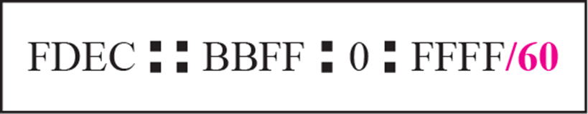
IPV6 CIDR
A destination address can be
Unicast
Multicast
Anycast
TCP IP Protocol Suite - Behrouz A. Forouzan

Slide 35
IPV6 Anycast
A group of computers that all share a single address.
A packet with an anycast address is delivered to only one member of the group, the most reachable one
An anycast communication is used when there are several servers that can respond to an inquiry.
The request is sent to the one that is most reachable.
The addresses are assigned from the unicast block not from IPv6.

Slide 36
IPV6 Unicast/Multicast
Unicast
A block of address assigned by IPv6
Multicast
Each member of the group receives a copy
A block is assigned by IPv6
No broadcast in IPv6
Special case of multicast

Slide 37
IPV6 Anycast
A group of computers that all share a single address.
A packet with an anycast address is delivered to only one member of the group, the most reachable one
An anycast communication is used when there are several servers that can respond to an inquiry.
The request is sent to the one that is most reachable.
The addresses are assigned from the unicast block not from IPv6.

Slide 38
IPV6 Anycast
A group of computers that all share a single address.
A packet with an anycast address is delivered to only one member of the group, the most reachable one
An anycast communication is used when there are several servers that can respond to an inquiry.
The request is sent to the one that is most reachable.
The addresses are assigned from the unicast block not from IPv6.

Slide 39
IPV6 Address
a. An address with 64 0s followed by 64 1s.
b. An address with 128 0s.
c. An address with 128 1s.
d. An address with 128 alternative 1s and 0s.
Abbreviated Address
a. :: FFFF:FFFF:FFFF:FFFF
::
FFFF:FFFF:FFFF:FFFF:FFFF:FFFF:FFFF:FFFF
d. AAAA:AAAA:AAAA:AAAA:
AAAA:AAAA:AAAA:AAAA
Unabbreviated Address
a. 0000:0000:0000:0000:FFFF:FFFF:FFFF:FFFF
b. 0000:0000:0000:0000:0000:0000:0000:0000
c. FFFF:FFFF:FFFF:FFFF:FFFF:FFFF:FFFF:FFFF
d. AAAA:AAAA:AAAA:AAAA:AAAA:AAAA:AAAA: AAAA

Slide 40
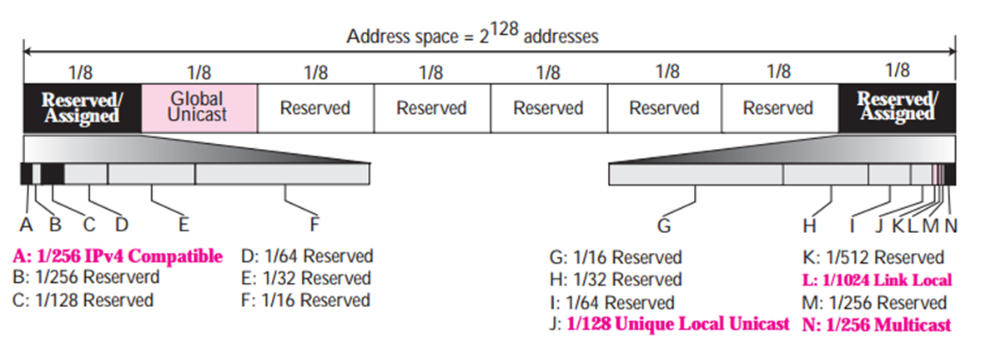
IPV6 Address
Address space of IPv6 is divided into
8 blocks of varying size and each block is allocated for special purpose.
TCP IP Protocol Suite - Behrouz A. Forouzan

Slide 41
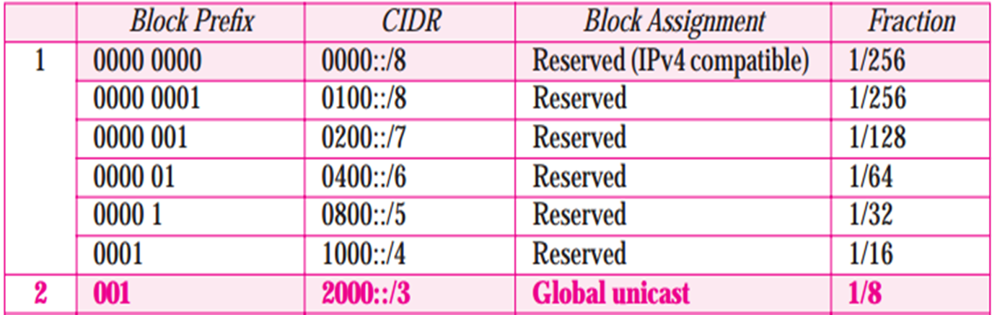
IPV6 Address
IPv6 First , Second block
Compute number of Unicast address?
TCP IP Protocol Suite - Behrouz A. Forouzan

Slide 42
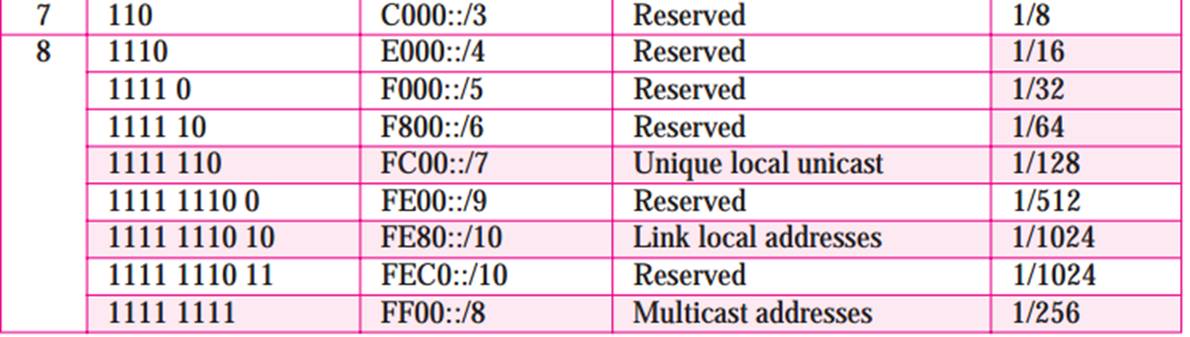
IPV6 Address
IPv6 Sixth, Eight block
Compute number of Unicast address?
TCP IP Protocol Suite - Behrouz A. Forouzan

Slide 43
IPV6 to IPV4 comm
Mapped Format
Used to send data from IPv6 to IPv4 computer
80 bits of zero, followed by 16 bits of one,
followed by the 32-bit IPv4 address.
0::FFFF:2.13.17.14

Slide 44
IPV6 to IPV6 comm
Compatible format
Used to send data from IPv6 to IPv6 computer
96 Zeros followed by 32 bit IP address.
IP address 2.13.17.14 will be
0::2.13.17.14
::/96 Sub block is reserved

Slide 45
Problems

Slide 46
Problem 1
1.What is the maximum value that the random number R can take in the Exponential Back-off algorithm used in CSMA/CD when a frame transmitted collides for the 8th time?
Ans:On the 8th collision, R can take any value between 0 and 2⁸ - 1 (= 256-1 = 255)
Hence, the maximum value that R can take is 255.

Slide 47
Problem 2
If there are 13 devices connected to a channel using CDMA, what divisor should be used by the receiver after decoding to extract the data?
Ans:
In CDMA, if there are n devices connected to a channel, on decoding the data at the receiver side, the resultant will be n * data.
Hence, to obtain the data, the decoded data should be divided by ‘n’ to extract the data. In this case, n = 13, divisor = n = 13

Slide 48
Problem 3
What will be the vulnerable time for collision in a slotted ALOHA network transmitting 1350 bit frames on a shared channel of 12 Mbps?
Solution:
Frame transmission time = Size of frame / Bandwidth
= 1350/(12 * 1024 * 1024)
= 0.000107288 s
= 0.1073 ms
In Slotted ALOHA, Vulnerable time = Frame transmission time = 0.1073 ms

Slide 49
Problem 4
In a channel using TDMA, the rate of transmission for each of the 10 devices connected to the channel is 24 Kbps. If 2 devices are additionally connected to the same channel, then what will be the rate of transmission for each device?
Solution:
In TDMA, Transmission rate for each device = Bandwidth of channel / number of devices
Bandwidth of channel = Transmission rate for each device * number of devices
= 24 Kbps * 10 = 240 Kbps
If 2 devices are added newly, total number of devices in channel = 10 + 2 = 12
Hence, Transmission rate for each device = 240 Kbps / 12 = 20 Kbps

Slide 50
Problem 5
In a link shared by 10 devices, p-persistent CSMA is used. If the length of the link is 102 m and the speed at which data can be transmitted in the link is 512 km/hr, then what is the duration of each time slot?
Solution:
In p-persistent CSMA, each time slot = maximum propagation delay
= length of link / speed
= 102 / (512 * 1000) hr
= 0.000199219 hr
= 0.7172 s

Slide 51
Problem 6
A sender sends a series of packets to the same destination using 4-bit sequence numbers. If the sequence number starts with 0, what is the sequence number after sending 97 packets?
Answer:
Sequence number range for 4 bit sequence = 0 to 15.
The sequence number in the Nth packet is (N mod 15). This means that the 98th packet has the sequence number (98 mod 15) = 8

Slide 52
Problem 7
Find out the max window size in sender and receiver side for Go back -NARQ if it uses 4 bit sequence numbers
Answer
Go back NRQ – sender size window calculation = 2^{m} -1 ->2⁴⁻1->15
Receiver size window =1 so answer is option D (15,1)

Slide 53
Problem 8
The bandwidth of the line is 1.5 Mbps with round trip time (RTT) as 45 milliseconds. If the size of each packet is 1 KB (kilobytes), then what is the efficiency in Stop and wait protocol?
Answer:
So in order to find the efficiency, lets first calculate the propagation delay (p) and transmission delay(t). You know that,
(2*p) = RTT = 45 ms
Therefore,
p = 45/2 = 22.5 ms
Now, lets find transmission delay (t), you know that, t = L/B (where, L= size of packet and B= bandwidth).
Therefore,
L = 1KB = (1024*8) = 8192 bitsAnd B = (1.5*10⁶)
So, t = L/B = 8192/(1.5*10⁶) = 5.461 ms
Thus efficiency,
= 1/(1 + 2a) {where a = p/t = 22.5/5.461 = 4.12}
= 1/(1 + 2*4.12)
= 0.108
= 10.8 %

Slide 54
What is the maximum window size for data transmission Using Selective Repeat protocol with n-bit frame sequence number?
Answer:
Since, window size of sender(W) = window size of the receiver(R) and we know that,
(W + R) = 2^{n}or, (W + W) = 2^{n} since,
(W = R) or, 2*W
= 2^{n} or,
W = 2^{n-1}

